Slide 1
Team-based Development with Version Control
Steve Jones
Editor in Chief
SQL Server Central, Red Gate Software

Slide 2
Goals
The value of version control
Standards, patterns and best practices
Flow in a team
Notes:
Understand why version control is important?
Learn some standards, patterns and best practices
- demo – show tracking without version control
- demo - set up vcs
See flow in a team
- demo - show objects being moved from person to person in separate databases
- demo – show tests

Slide 3
How many of you use version control for you application code?
C#, ASP.NET, Javascript, VB.NET, etc.
Notes:
How many people in the audience use version control for their application code? Any of your front end code.
* Note number

Slide 4
How many of you use version control for you application code?
database
Notes:
Let’s ask the same question. How many of you use version control for your database code? For your tables, views, procedures? What about schemas? What about permissions and roles? What about cryptographic keys?
* Note number and difference.

Slide 5
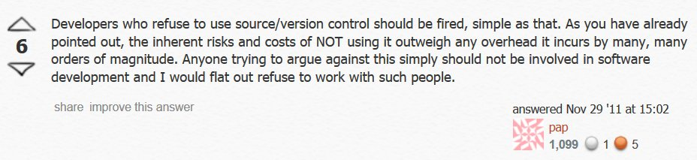
Notes:
There are plenty of developers with this attitude, though I’m not sure it’s the majority. As software development matures, however slowly, I suspect this will become more and more commonplace. Professionals should work professionally.
http://programmers.stackexchange.com/questions/122150/how-can-i-convince-cowboy-programmers-to-use-source-control
http://www.makeuseof.com/tag/git-version-control-youre-developer/
http://www.mactech.com/articles/mactech/Vol.14/14.06/VersionControlAndTheDeveloper/index.html
http://drupal.org/node/299067
grammers.stackexchange.com/questions/122150/how-can-i-convince-cowboy-programmers-to-use-source-control

Slide 6
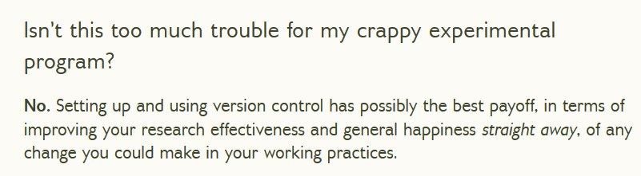

Notes:
Version control isn’t that hard.
http://programmers.stackexchange.com/questions/122150/how-can-i-convince-cowboy-programmers-to-use-source-control
http://www.makeuseof.com/tag/git-version-control-youre-developer/
http://www.mactech.com/articles/mactech/Vol.14/14.06/VersionControlAndTheDeveloper/index.html
http://drupal.org/node/299067

Slide 7
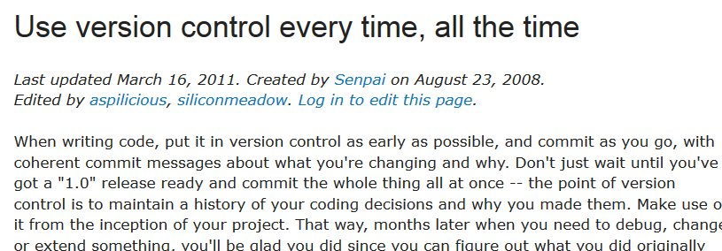

Notes:
VCS should be used everywhere, all the time.
http://programmers.stackexchange.com/questions/122150/how-can-i-convince-cowboy-programmers-to-use-source-control
http://www.makeuseof.com/tag/git-version-control-youre-developer/
http://www.mactech.com/articles/mactech/Vol.14/14.06/VersionControlAndTheDeveloper/index.html
http://drupal.org/node/299067

Slide 8

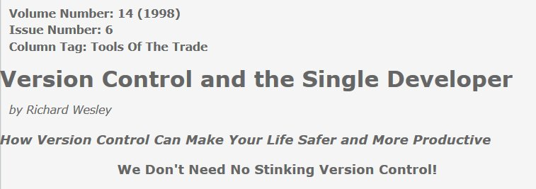
Notes:
There are no excuses where you should not use it.
http://programmers.stackexchange.com/questions/122150/how-can-i-convince-cowboy-programmers-to-use-source-control
http://www.makeuseof.com/tag/git-version-control-youre-developer/
http://www.mactech.com/articles/mactech/Vol.14/14.06/VersionControlAndTheDeveloper/index.html
http://drupal.org/node/299067

Slide 9
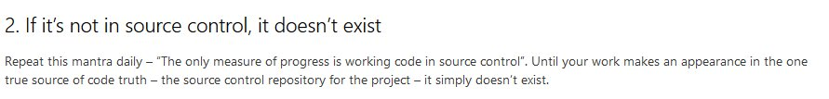
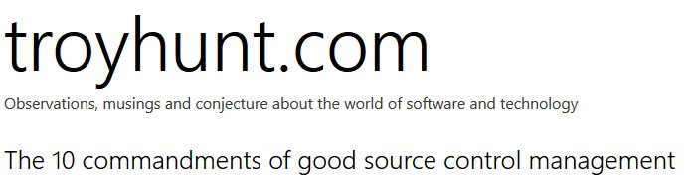
“If it’s not in source control, it doesn’t exist.”
Notes:
Your version control, or source control system, should be the last word in what code is included in your application.
Source control provides you this central repository that helps everyone be aware of what changes have been made.
http://www.troyhunt.com/2011/05/10-commandments-of-good-source-control.html

Slide 10
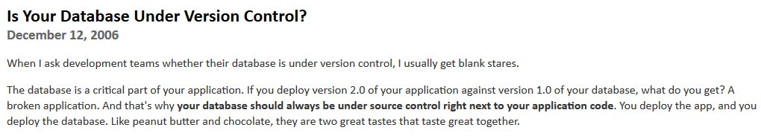

“…your database should always be under source control right next to your application code.”
Notes:
Many of the better developers out there, whether working with application code or database code, believe in this process. In terms of databases, the code should be a peer with your application code.
From: http://www.codinghorror.com/blog/2006/12/is-your-database-under-version-control.html

Slide 11
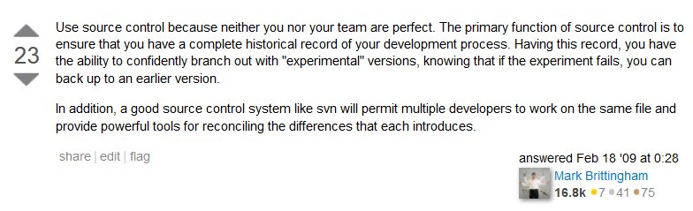
The Best Reason
‘Use source control because neither you nor your team are perfect”
Notes:
You use source control because neither you nor your team is perfect.
http://stackoverflow.com/questions/559332/why-should-my-team-adopt-source-control

Slide 12
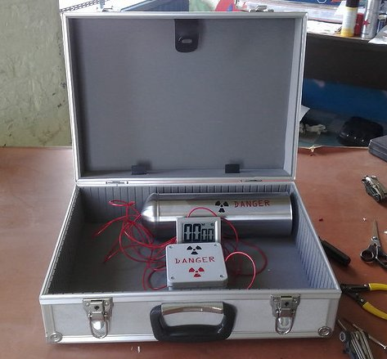
Notes:
In most jobs you want to be able to rollback if you make a mistake. You can't sometimes, but we often can in software
development. In software we aren’t usually working in areas quite this critical, but the lack of having a safety net for your application can be a problem.
http://www.flickr.com/photos/spinneyhead/3616976884/

Slide 13
Demo
Getting starting with databases and VCS
Notes:
How hard is it to set up source control? Let’s look
Show how to start using VCS manually with a database and scripting (file open/close)
Create SimpleTalkDev_Steve and SimpleTalkDev_Manual.
Script out _Manual
Add to subversion
Link _Steve to SOC to show the difference
Change a proc in _Manual, save, check in.
Change a proc in _Steve, commit change.

Slide 14

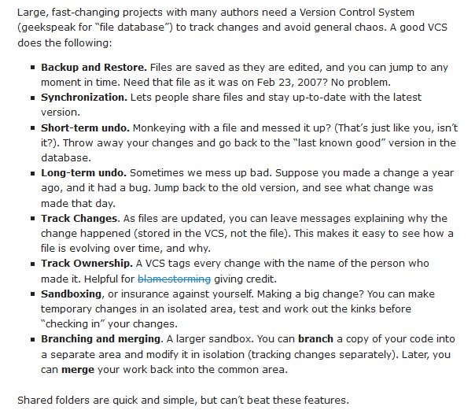
Notes:
VCS isn’t just for rolling back changes. There are any number of benefits to a shared VCS environment.
You can see there a variety of reasons why you should use source control, but…
http://betterexplained.com/articles/a-visual-guide-to-version-control/

Slide 15

Reducing Risk
Notes:
they all come down to reducing risk. Reducing the risk of problems in your code, conflicts, the chance you cannot build your application to add a feature, apply a patch, or grow your team.
Many of the things we talk about at SitC are all about reducing risk. Continuous integration, continuous deployment, processes made easier with tooling, all are about reducing risk.
How many of you would code your entire project and only build it at the end? That’s what not using version control, testing, practicing, having a known process is really like.

Slide 16
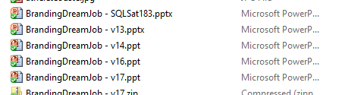
You’re using version control

Slide 17
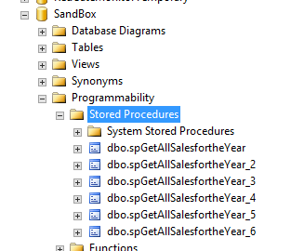
You’re using version control

Slide 18
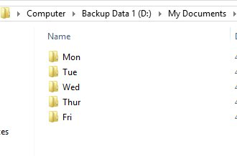
Use Something
Notes:
If you don't like the idea of using a server based system, or your company doesn't have one, please use something. If nothing else, back up your code each day.

Slide 19

Automation is Best
Notes:
However we prefer automation. We want to use some sort of tooling to make this process easier. Most IDEs integrate with VCS systems, though SSMS is not one. However there are different ways to do this, as we saw in the demo.
http://www.youtube.com/watch?v=RG0ochx16Dg

Slide 20
Automation is Best
VCS Plug-ins for IDEs
SQL Source Control
Schema Audit
Scan for changed objects, compare with VCS
Alert developers
Automated Check-in
Script all objects
Check-in with date
Notes:
However we prefer automation. We want to use some sort of tooling to make this process easier. Most IDEs integrate with VCS systems, though SSMS is not one. However there are different ways to do this, as we saw in the demo.
http://www.youtube.com/watch?v=RG0ochx16Dg

Slide 21

Rules for Database Development
Never use a shared database for development
Always Have a Single, Authoritative Source For Your Schema
Always Version Your Database
http://odetocode.com/blogs/scott/archive/2008/01/30/three-rules-for-database-work.aspx
Notes:
In team development, we should have a number of rules. The best list I have seen is from K. Scott Allen, with three rules.
- Never used a shared database for development
- Always have an authoritative source
- version your database
All three are important. You don't want a shared database because when testing change and trying out new enhancemnents, especially in database
work, you do not want one developer to interfere with others. This is especially problemativ for database work where the structure you are
dealing with must be able to work well across time. You always need a source for your database any point in time if you hae to rebuild things.
This means you may have create scripts or alter scripts, but whatever combination you have must work to rebuild a database to match a point in
time. The last thing is that your database state should be known at different points in time, espeically as you may deploy changes out of order
in which they are built. These versions usually correspond to release points, and they are important for building upgrade scripts for altering
objects.
From: http://odetocode.com/blogs/scott/archive/2008/01/30/three-rules-for-database-work.aspx (K. Scott Allen)

Slide 22
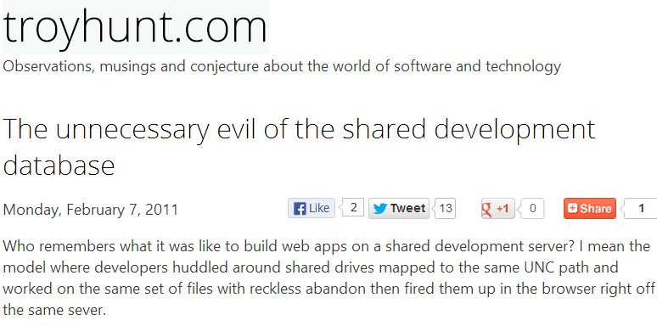
Dedicated or Shared Databases?
Notes:
http://www.troyhunt.com/2011/02/unnecessary-evil-of-shared-development.html

Slide 23
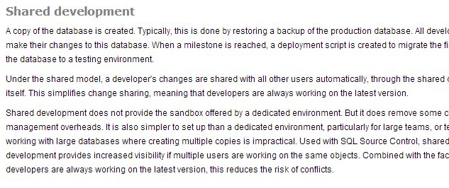
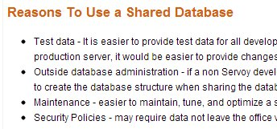
Shared databases are not wrong
Notes:
http://wiki.servoy.com/display/public/DOCS/Team+Development+Database+Considerations+-+Shared+Versus+Local;jsessionid=21F4E584D19A38E010382144904496ED

Slide 24

The Ideal
Each developer has a dedicated environment with a copy of the schema and minimal data.
A shared integration environment where all developers’ changes are merged, available for developer testing.
Notes:
The holy grail, the ideal environment is a set of dedicated databases for individual development, but a shared integration database where all changes are merged, and at any time, the developer can test their code against this database.
We support both models very well with the Red Gate tools.
http://www.red-gate.com/SupportCenter/content/SQL_Source_control/articles/SSC_Development_Models

Slide 25
VCS Systems
Team Foundation Server (TFS)
Git
Mercurial
Subversion
Visual Sourcesafe
CVS
Vault
Rational
Lots here: http://en.wikipedia.org/wiki/Comparison_of_revision_control_software

Slide 26

Teamwork
Notes:
Ultimately what we want to do is ensure that everyone in our team, however big or small, works together in a coordinated fashion. We won't all work the same way, but we don't want to create friction and inefficiencies with our differences.
Teamwork requires coordination and communication to be efficient. Whatever process you choose needs to work for the team. It should allow them to easily work in the way they want, while still allowing each team member’s work to be easily integrated into every other team members.
http://www.flickr.com/photos/lumaxart/2137737248/

Slide 27
Teamwork
Communication
Team members need to be aware of (easily) what others are doing.
Coordination
Teams need to work in a way that complements each other.
Notes:
The big things are communication and coordination. Communication betwen members as well as with the application. Knowing when you have code that
changes, that works (or doesn't work) and what items people are working on. Coordination has to do with meshing the different ways we all work
together.
In terms of communication, talk to each other (or email, IM, chat, etc.). Don't set very hard and fast rules that are unbreakable, but discuss
issues and make reasonable decisions that fit in your environment. If things make sense and help you develop faster and at a higher level of
quality, do them. If they don't, then change.

Slide 28
Demo
Flow in a team
Notes:
Show changes moving from one developer to another. Show tests
-- Demo changes to code, with comments, appearing in source control and using those.
- David A’s TDD scenario. Create test, allow to flow to the other user.

Slide 29
Naming Standards
Usually vary by company
ISO 1179
Be consistent
Use tools for enforcement (SQLCop)
Document these lightly and JIT
Notes:
Naming standards have to do with how we identify things. From servers, to databases, to tables to programming structures, we want consistent
naming so all members of the team understand quickly and easily, what they are working with. These can include well known standards (ISO), but
they do not have to. The important thing is they are defined, even loosely defined, in your company. You should use tools and automation to
enforce them. I would not define everything up front and right away, but define things as needed.

Slide 30
Style Standards
Vary by individual
Make code more readable.
Use tools to re-format code to your liking.
SQL Prompt
SSMS Tools Pack
Others
Demo – Reformatting code
Notes:
Style standards often vary by individual. These have to do with the formatting and layout of code to enhance readability and understanding.
However it doesn't make sense these days to have strict standards for formatting of code. Instead, the IDE should be able to reformat code for
the developer as needed. This might include things like spacing, comma placement, etc. Tooling can handle many of these issues. There are a
number of add-ins and editors for SQL Server code. Learn to use them.

Slide 31
Use Tools
Development systems and tools need to work for the team, not against them.
Many IDEs and tools work well in team environments, if you configure them.
Notes:
Automation and tooling is definitely the key to good teamwork. The tools should help not only enable, but foster good teamwork. Configure your
IDEs to help you. Share knowledge and configuration while allowing diversity in things like personal preferences.

Slide 32
Get Everything
Object DDL
Assembly code
Security code
Configuration settings
Jobs
Lookup data
Notes:
Your code consists of a number of objects. The things we talk about should apply to all of these.

Slide 33
Best Practices
Use version control for all code (including tests)
Commit early, commit often (references for this one)
Use tools
If it’s hard, people don’t do it
Train people
Build often
Notes:
The best practices for database development are:
- Use version control. It's important for a variety of reasons, not the least of which is reducing your risk of problems.
- Commit often. Better sooner than later.
- Use tools to help you work better. These can be bespoke or bought, but use them to make things work easier. Your tools should be able to build
a database ona new machine quickly and easily. Backup and restore can work, but this isn't always practical.
- Train your people. Don't assume they know how to use VCS, or they have the habits. It doesn't take long, and it's worth the investment.
- Build often. This will help you catch mistake and issues early, which means it is less costly in terms of resources to fix things.

Slide 34
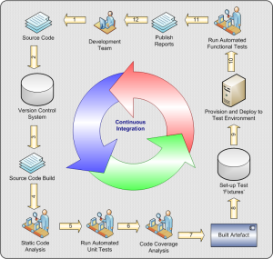
The Holy Grail
Notes:
The holy grail of all of this is to be able to release at any point in time, if you need to, with confidence. If you have a problem, an urgent
request, a deadline, being able to build your applicatin (and database) with confidence, test it quickly, and deploy changes. Continuous
Integration, Continuous Deployment, and the automation that goes with them is what w should all shoot for.
http://indianajones.wikia.com/wiki/Holy_Grail
http://mikeciblogs.wordpress.com/2010/06/15/continuous-integration-for-agile-project-managers-part-3/

Slide 35
Goals
The value of version control
Standards, patterns and best practices
Flow in a team
Notes:
Understand why version control is important?
Learn some standards, patterns and best practices
- demo – show tracking without version control
- demo - set up vcs
See flow in a team
- demo - show objects being moved from person to person in separate databases
- demo – show tests

Slide 36
The End
The next step is Automated Test and Build (next session)
Questions?
Please fill out your feedback forms
www.voiceofthedba.com/talks

Slide 37
References
http://stackoverflow.com/questions/115369/do-you-use-source-control-for-your-database-items
http://www.codinghorror.com/blog/archives/001050.html
http://www.codinghorror.com/blog/2008/02/get-your-database-under-version-control.html
http://www.ssw.com.au/ssw/Standards/Rules/RulesToBetterSQLServerDatabases.aspx
http://odetocode.com/blogs/scott/archive/2008/01/30/three-rules-for-database-work.aspx
Check in early, check in often - http://www.codinghorror.com/blog/2008/08/check-in-early-check-in-often.html
SVN and Powershell - http://www.hanselman.com/blog/PowerShellAnkhSVNAndSubversion.aspx

Slide 38
Images
http://northernalberta.rims.org/NorthernAlbertaChapter/Home/
http://indianajones.wikia.com/wiki/Holy_Grail
http://www.youtube.com/watch?v=RG0ochx16Dg
http://www.flickr.com/photos/lumaxart/2137737248/

